Slide 1
Digital Circles and the Groups they Attract
Notes:
Digital Circles and the Groups they Attract

Slide 2
Contents of this video
Here’s what you’ll find in this short, informative video:
Student types - Information about the types of students who may use, and benefit from, digital circles
Group intersections - Information around how these groups can intersect
Student engagement - Guidance on how to engage these students and suggestions for doing so
Key questions - A set of questions to use when planning digital circles, with these students in mind
Notes:
In this short, informative video we’ll be looking at:
Firstly we’ll look at information about the types of students who may use, and benefit from, digital circles
Secondly we’ll discuss how these groups can intersect
Then we’ll provide guidance on how to engage these students and suggestions for doing so
Finally we’ll provide a set of questions to use when planning digital circles, with these students in mind

Slide 3
01
Student Types
Notes:
Section 1 – Student types. There are four types of students that we will address in this video.

Slide 4
01 – Student Types – Commuter
Definition:
Anyone who does not live in institution-owned housing, on campus (1).
Notes:
Firstly we will talk about commuter students. These are considered as anyone who does not live in institution owned housing on campus

Slide 5
01 – Student Types – Commuter continued
Challenges they may face include:
Loneliness/not connected with campus activities
Commuting expenses/transport issues
Time management pressures
Increased likelihood of anxiety/depression due to commuting pressures (2)
Notes:
Some of the challenges that they may face include:
Loneliness/not connected with campus activities
Commuting expenses
Time management pressures
Nuisance/traffic frustration
Increased likelihood of anxiety/depression due to commuting pressures.

Slide 6
01 – Student Types – Distance
Definition:
A distance learner is someone who does not live on, or commute to, campus.
Distance learning is used to describe education delivered to physically distant/remote locations “via print, audio, video (live or prerecorded) and/or computer technologies, including both synchronous and asynchronous instruction” (3).
Notes:
Now we will discuss distance learners. . A distance learner is someone who does not live on or commute to campus.
Distance learning is used to describe education delivered to physically distant/remote locations “via print, audio, video (live or prerecorded) and/or computer technologies, including both synchronous and asynchronous instruction” (3).
Synchronous means in real time and asynchronous means pre-recorded materials.

Slide 7
01 – Student Types – Distance continued
Challenges they may face include (4):
Lack of equipment and use of university facilities
Poor technical assistance
Lack of contact with lecturers/peers
Alienation and isolation
Limited access to student support services such as, counselling
Notes:
Challenges they may face include
Lack of equipment and use of university facilities
Poor technical assistance
Lack of contact with lecturers/peers
Alienation and isolation
Poor student support services

Slide 8
01 – Student Types – Placement
Definition:
A placement is a period of work experience which is an integrated and assessed part of a student’s degree, therefore it is different to an internship, which is extra-curricular.
Placements require students to apply their learning from the course in the workplace, and apply learning from the workplace in the course (5).
Notes:
Next, we have placement students. A placement is a period of work experience which is an integrated and assessed part of a student’s degree, therefore it is different to an internship, which is extra-curricular. Placements require students to apply their learning from the course in the workplace, and apply learning from the workplace in the course (5).

Slide 9
01 – Student Types – Placement continued
Challenges they may face include (6):
The nature of the work differs from expectations and career goals
Assigned inappropriate levels of work
Too much workload affecting performance, causing anxiety and job dissatisfaction
Practical issues (financial and lifestyle)
Notes:
Challenges they may face include:
The nature of the work differs from expectations and career goals
Assigned inappropriate level of work
Too much workload affecting performance, causing anxiety and job dissatisfaction
Practical Issues (Financial and Lifestyle)

Slide 10
01 – Student Types – Mature
Definition:
Mature students refer to students aged 21 years and over, that are enrolled on a full-time or part-time basis, at an institution of higher learning after a long period of time out of school (7).
Notes:
Finally, we have mature students. Mature students refer to students aged 21 years and over, that are enrolled on full-time or part-time basis at an institution of higher learning after a long period of time out of school.

Slide 11
01 – Student Types – Mature continued
Challenges they may face include (8):
Financial constraints
Time management
Social integration
Work-life-education balance
Anxiety around academic performance
Notes:
Challenges they may face include
Financial constraints
Time management
Social integration
Work-life-school balance
Anxiety around academic performance
So, you might belong to or know someone who belongs to one of these groups without even realizing it!

Slide 12
02
Group Intersections
Notes:
Section 2 – Group intersections - Now that we know what each student group is let’s talk about group intersections.

Slide 13
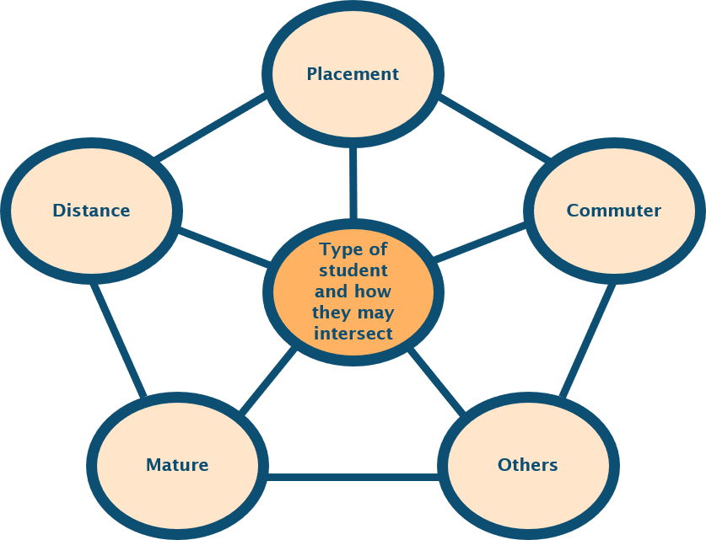
02 – Group Intersections
Intersect means when two or more things cross over and connect.
Notes:
The web-like diagram illustrates how the student types discussed could intersect. Intersect means when two or more things cross over and connect. Examples of this at a university setting include, a working mother who lives at home and not on campus would be a mature student and a commuter student; or an international student who has a placement as part of their studies, would be a distance learner and a placement student; or a student could be older than 21, commute into university and also have a placement (that’s three intersections!).
Since each of these student groups face their own challenges, upon their intersection these will automatically increase. For instance, failure to consider this can result in overlooking students’ needs and the difficulties they may face (excess stress, feeling disconnected) and universities need to consider how digital circles could help aid their experiences and wellbeing.

Slide 14
03
Student Engagement
Notes:
Section 3 – Student engagement - Given the examples of group intersections shown, how do we engage these students in digital circles?

Slide 15
03 – Student Engagement
Have a digital circle for each type of student, to enable integration and a sense of belonging to develop.
Allow for social/personal communications outside academic requirements to take place, for better chances of bonding and connecting.
Notes:
Our suggestions for this are:
Have a digital circle for each type of student, to allow for integration and a sense of belonging to develop.
Allow for social/personal communications outside academic requirements to take place for better chances of bonding and connecting.

Slide 16
03 – Student Engagement continued
Build a digital circle where inclusive imagery, language and resources are used to ensure all types of students are considered and no-one is left out.
Ask students on arrival what they would prefer before creating a digital circle - for example, mature students may prefer information sharing in the evenings.
Notes:
Build a digital circle where inclusive imagery, language and resources are used to ensure all types of students are considered and no-one is left out.
Ask students on arrival what they would gain from joining a digital circle – for example, mature students may prefer information sharing in the evenings.

Slide 17
04
Key Questions
Notes:
Finally, section 4- Key questions. There are some key questions that should be considered when planning digital circles with these students in mind. We recommend using these questions as discussion prompts.

Slide 18
04 – Key questions
How can cultural and time zone differences be overcome for distance learners, who are also mature students and have other priorities (children, work schedules, etc.)?
What steps will be taken if distance learners develop technology-dependence or feel overwhelmed by message overload?
Notes:
Question1: How can cultural and time zone differences be overcome for distance learners, who are also mature students and have other priorities (children, work schedules, etc.)?
What steps will be taken if distance learners develop technology-dependence or feel overwhelmed by message overload?

Slide 19
04 – Key questions continued
How will students with special needs be supported whilst on placement?
How will time constraints (including work and family commitments) be accounted for, for students who set up and run digital circles?
Notes:
How will students with special needs be supported whilst on placement?
How will time constraints (including work and family commitments) be accounted for, for students who set up and run digital circles?
Thank you for listening to our video about how different groups of students intersect and how digital circles can aid their experiences and wellbeing whilst in higher education.

Slide 20
References
Wang X, Rodríguez DA, Sarmiento OL, Guaje O. Commute patterns and depression: Evidence from eleven Latin American cities. Journal of Transport & Health. 2019 Sep;14:100607.
SPARK. Why is Student Wellbeing important? [Internet]. SPARK. 2021. Available from: https://spark.school/wellbeing/why-is-student-wellbeing-important
Cain DL, Marara C, Pitre PE, Armour S. Support services that matter: An exploration of the experiences and deeds of graduate students in a distance learning environment. Journal of Distance Education. 2003;18(1):42–56.
Musingaf MCC, Mapuranga B, Chiwanza K, Zebron S. Challenges for Open and Distance learning (ODL) Students: Experiences from Students of the Zimbabwe Open University. Journal of Education and Practice. 2015;6(18).
5. placement Y, placements 5, University S. 10 things you need to know about placements | Sheffield Hallam University [Internet]. Shu.ac.uk. 2022 [cited 12 July 2022]. Available from: https://www.shu.ac.uk/student-placements/10-things-you-need-to-know-about-placements
6. Fanthome C. Work Placements - a Survival Guide for Students. London: Macmillan Education, Limited; 2017.
Gardelisi S, Heinz A, Kastrup M, Beezhold J, Sartorius N. Toward a new definition of mental health. National Library of Medicine [Internet]. 2015 Jun 4 [cited 2022 Jun 6];14(2). Available from: https://www.ncbi.nlm.nih.gov/pmc/articles/PMC4471980/
Hunter A. Supporting the Mental Health of Mature Higher Education Students [Internet]. FE News. 2021. Available from: https://www.fenews.co.uk/fe-voices/supporting-the-mental-health-of-mature-higher-education-students/
Mature Students-surviving and thriving [Internet]. warwick.ac.uk. Available from: https://warwick.ac.uk/services/wss/topics/mature_students-surviving_and_thriving/

